Slide 1
Data Science Career Track Capstone Project-1
King County
House Price Prediction
Gokmen Oran
March 2019

Slide 2
Table of Contents
Problem Statement
Data Specifications
Data Wrangling
Exploratory Data Analysis
Inferential Statistics
Machine Learning
Conclusion

Slide 3

Problem Statement
“Is it possible to predict the sale price of a house from information about that house provided in the dataset, such as square footage of the home, number of bedrooms, number of bathrooms, number of floors, condition, grade, etc?”

Slide 4


Data Specifications
Houses sold in King County, Seattle, Washington between May 2014 and May 2015.
21613 observations and 21 features
No missing data
Uploaded to the Kaggle website by the user harlfoxem (Data Source: https://www.kaggle.com/harlfoxem/housesalesprediction).

Slide 5

Data Wrangling
“View”, “Sqft_living15”, “Sqft_lot15” features – further investigation from King County official website
177 duplicated rows - kept the last entries, dropped the first ones
“id”, “date”, “lat”, “long” columns ➔ dropped
Removed 16 observations with zero bathroom or zero bedroom

Slide 6
Data Wrangling
Removed 1 observation with 33 bedrooms
“floors”, “waterfront”, “view”, “condition”, “grade” columns ➔ category
“zipcode” column ➔ string
21419 rows and 17 columns left in the dataset
Datatypes: category(5), float64(2), int64(9), object(1)

Slide 7
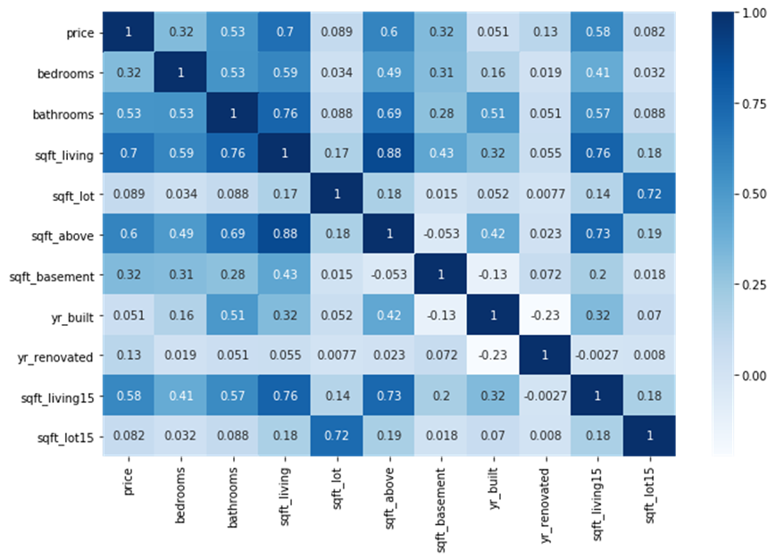
Exploratory Data Analysis
Correlation between the continuous variables

Slide 8
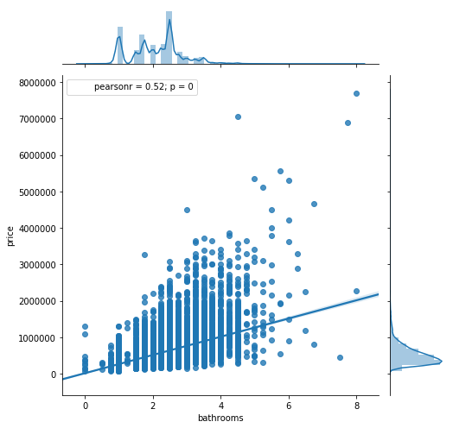
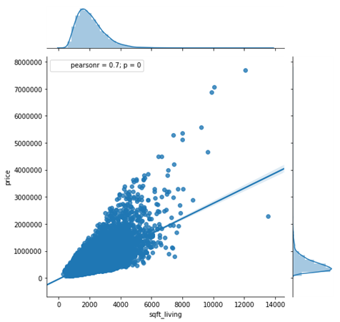
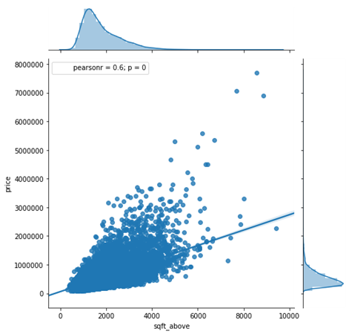
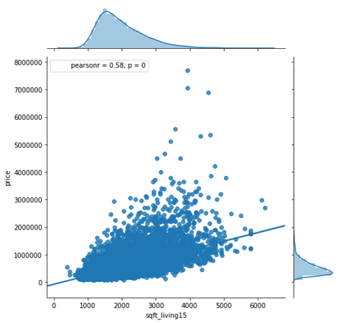
Exploratory Data Analysis
Correlation between the continuous variables

Slide 9
Exploratory Data Analysis
There are many zeros in the “sqft_basement” and “yr_renovated” variable.
Created new two columns ('basement_present', 'renovated'), and changed their types into category.
If the house has basement; 'basement_present' ➔ 1, otherwise ➔ 0
If the house was renovated 'renovated‘ ➔ 1, otherwise ➔ 0

Slide 10
Exploratory Data Analysis
point-biserial correlation
Relationship between ‘house price’ and the categorical variables ('waterfront', 'basement_present', 'renovated',
 | price
waterfront | 0.26
basement_present | 0.18
renovated | 0.12

Slide 11
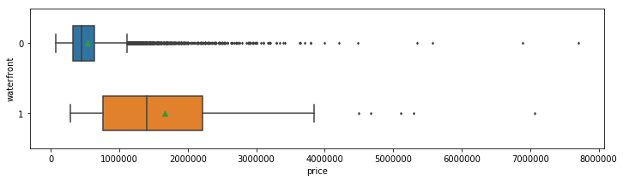
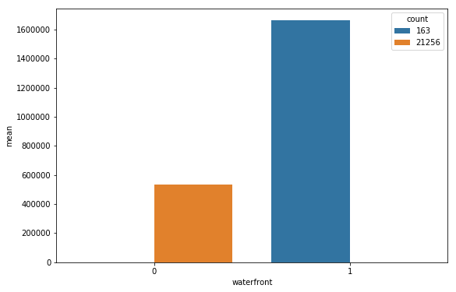
Exploratory Data Analysis
‘house price’ and 'waterfront‘ (r = 0.26)

Slide 12
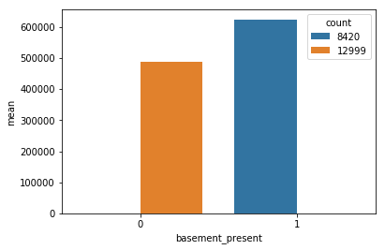
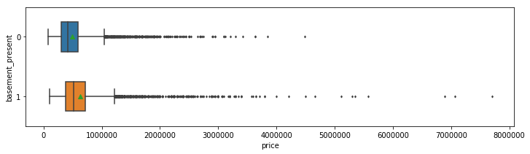
Exploratory Data Analysis
‘house price’ and 'basement_present’ (r = 0.18)

Slide 13
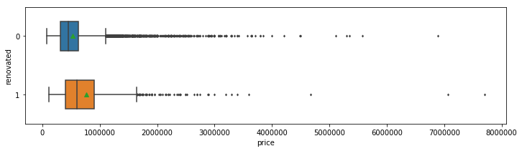
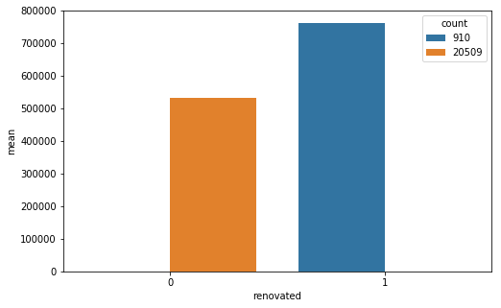
Exploratory Data Analysis
‘house price’ and ‘renovated’ (r = 0.12)
13/31

Slide 14
Exploratory Data Analysis
Spearman's rank-order correlation
 | price
floors | 0.32
view | 0.29
condition | 0.016
grade | 0.656
Relationship between ‘house price’ and the categorical variables ('floors', 'view', 'condition', 'grade‘)
14/31

Slide 15
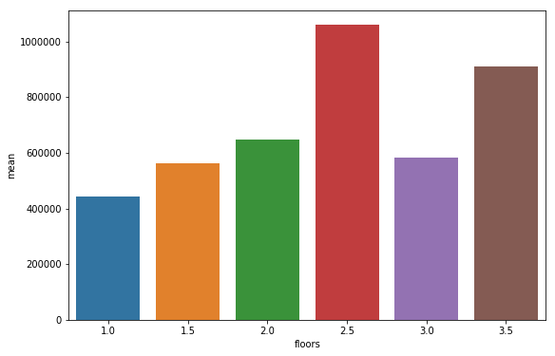
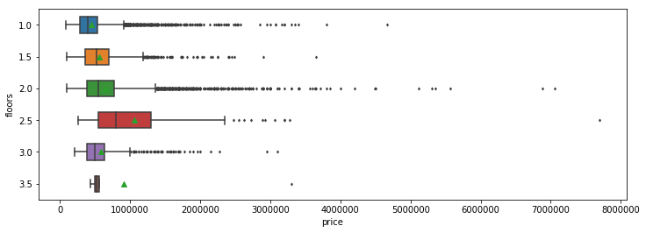
Exploratory Data Analysis
‘house price’ and ‘floors’ (r = 0.32)
15/31

Slide 16
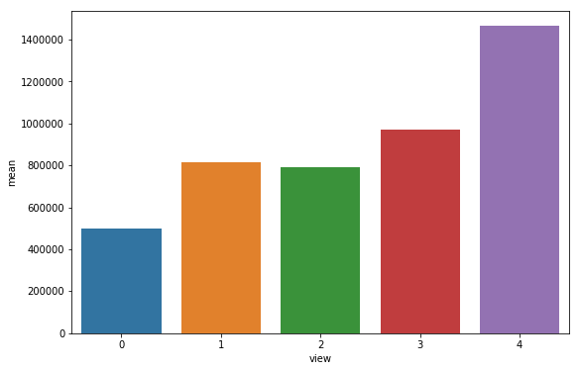
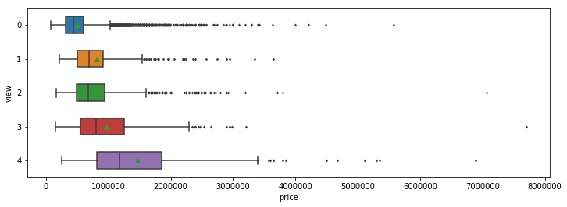
Exploratory Data Analysis
‘house price’ and ‘view’ (r = 0.29)
16/31

Slide 17
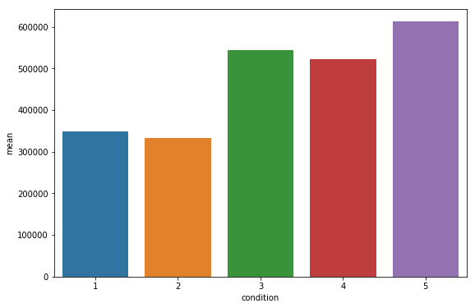
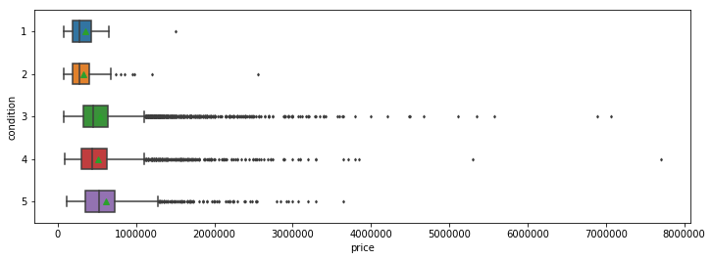
Exploratory Data Analysis
‘house price’ and ‘condition’ (r = 0.016)
17/31

Slide 18
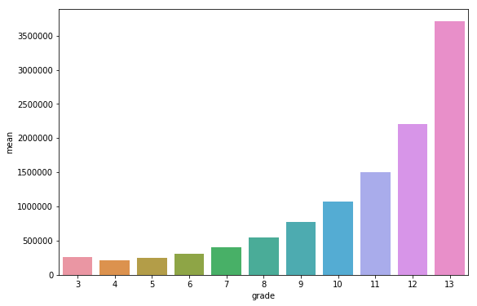
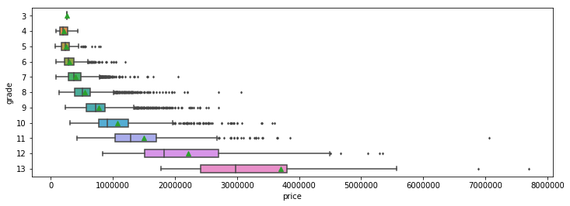
Exploratory Data Analysis
‘house price’ and ‘grade’ (r = 0.656)
18/31

Slide 19
Exploratory Data Analysis
Zipcode | mean | min | max | count | std
98039 | 2.186843e+06 | 787500.0 | 6885000.0 | 49 | 1.163564e+06
98004 | 1.355387e+06 | 425000.0 | 7062500.0 | 315 | 7.472826e+05
98040 | 1.194230e+06 | 500000.0 | 5300000.0 | 282 | 6.074935e+05
98112 | 1.096192e+06 | 169317.0 | 3400000.0 | 268 | 5.947617e+05
98102 | 8.993954e+05 | 330000.0 | 7700000.0 | 104 | 7.902389e+05
98109 | 8.796236e+05 | 216650.0 | 3200000.0 | 109 | 4.552288e+05
Relationship between ‘house price’ and the categorical variables (‘zipcode’)
There are 70 unique zip codes in the data, and when we examined the box plot, we can not infer any kind of relationship with price. However, we can say that the house prices in some specific zip code areas are high than the other zip code areas.
19/31

Slide 20
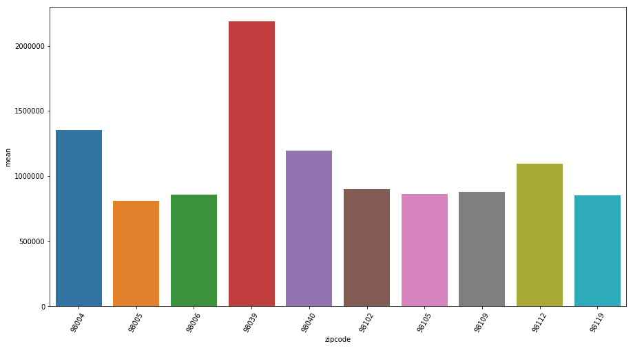
Exploratory Data Analysis
Relationship between ‘house price’ and the categorical variables (‘zipcode’)
20/31

Slide 21
Inferential Statistics
I performed the hypothesis testing to check if the correlation between price and other features (bedrooms, bathrooms, Sqft_living, and Sqft_above) happened by chance.
#H0: There is no significant correlation between number of bedroom and price.
#Ha: There is a correlation between number of bedrooms and price.
The p-value is less than level of significance 0.05, so we reject the null hypothesis. There is a correlation between number of bedrooms and price.
I also performed the hypothesis testing between price and other features mentioned above.
21/31

Slide 22
Machine Learning
Algorithms
Linear Regression (LR)
Ridge Regression(RR)
Lasso Regression(LassoR)
Support Vector Regression(SVR)
Decision Tree Regression (DTR)
Random Forest Regression(RFR)
Gradient Boosted Regression(GBR).
22/31

Slide 23
Machine Learning
Performance Evaluation
Mean Squared Error (MSE)
Root Mean Square Error (RMSE)
R2 score
Mean_Absolute_Error (MAE)
(I evaluated the performance of SVR model only according to R2 score).
23/31

Slide 24
Machine Learning
Additional Data Preparation before Applying Models
I applied one-hot encoding on 'waterfront', 'floors', 'view', 'condition', 'grade', 'basement_present', 'renovated' features.
I created the copy of ‘h_data’ dataset as ‘h_data_copy’. I applied one-hot encoding on 6 zip codes, which have highest mean of house prices, on ‘h_data’ dataset and I dropped the “zipcode” feature. I used this version on LR, RL, LassoR, and SVR models. I used both version of “zipcode” feature (one-hot encoding applied version and original version) on tree-based models.
24/31

Slide 25
Machine Learning
Additional Data Preparation before Applying Models
I applied “pandas.profiling” to see the latest changes and their effects on datasets. ‘renovated1’ feature is highly correlated with ‘yr_renovated’ feature (ρ = 0.99997). I decided to drop this feature.
I divided the data into independent variables “X and X_copy” and target variables “y and y_copy”.
I created a new data frame named “evaluation_matrix” to store the metrics of models.
25/31

Slide 26
Machine Learning
 | LinearReg | Ridge | Lasso | SVR | SVR_L
Mean_Squared_Error(MSE) | 3.37764e+10 | 3.3788e+10 | 3.37866e+10 | 0.326739 | 0.253243
Root_Mean_Squared_Error(RMSE) | 183784 | 183815 | 183811 | 0.571611 | 0.503232
R2_score | 0.751971 | 0.751886 | 0.751895 | 0.673261 | 0.746757
Mean_Absolute_Error(MAE) | 125387 | 125394 | 125416 | 0.328629 | 0.332053
 | Decision Tree | Decision Tree_ copy | Random Forest | Random Forest_ copy | Gradient Boosting | Gradient Boosting_ copy
Mean_Squared_ Error(MSE) | 5.89478e+10 | 5.80211e+10 | 2.79853e+10 | 2.44322e+10 | 2.602865e+10 | 1.911278e+10
Root_Mean_ Squared_Error(RMSE) | 242792 | 240876 | 167288 | 156308 | 161334 | 138249
R2_score | 0.56713 | 0.573935 | 0.794496 | 0.820588 | 0.8088645 | 0.8596496
Mean_Absolute_ Error(MAE) | 150482 | 127169 | 109315 | 88127.2 | 110167 | 83950.4
26/31

Slide 27
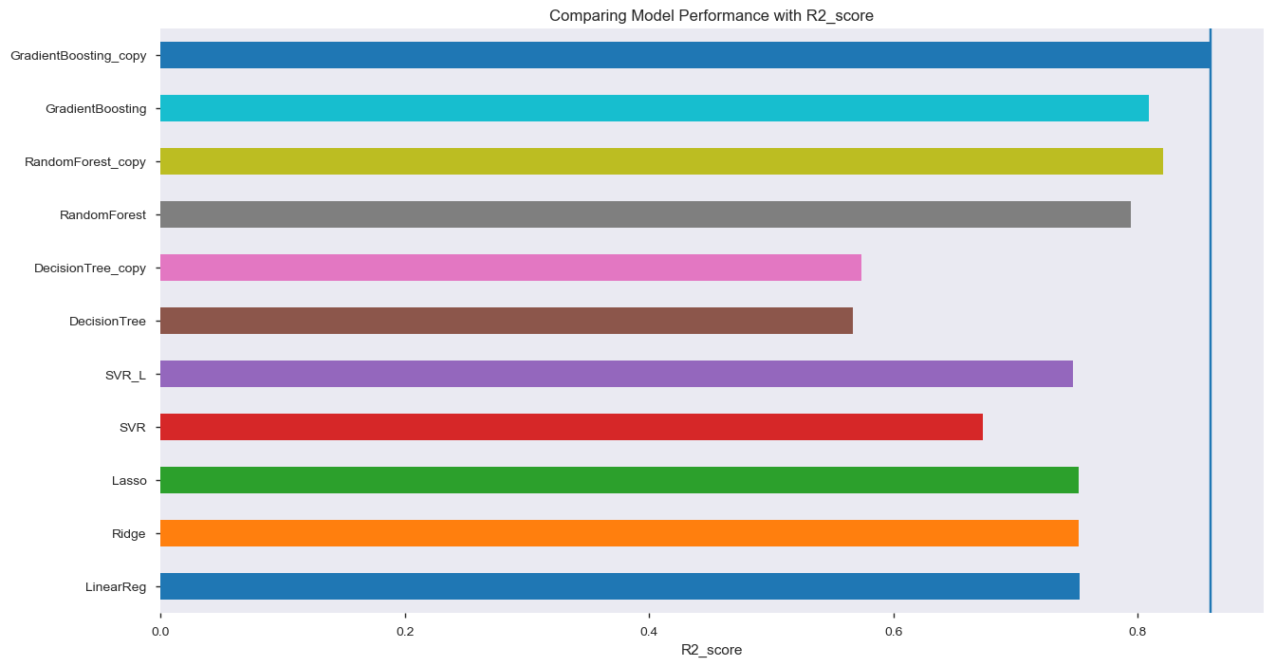
Machine Learning

Slide 28
Machine Learning
Hyperparameter Tuning
Linear Regression, Ridge, Lasso, and Decision Tree Regressor model ➔ GridSearchCV.
Random Forest Regressor and Gradient Boosting Regressor model ➔ RandomizedSearchCV.
cv = 5
28/31

Slide 29
Machine Learning
Hyperparameter Tuning
 | LinearReg_GSCV | Ridge_GSCV | Lasso_GSCV | DecisionTree_ GSCV | RandomForest_ RSCV | GradientBoost Regressor_ RSCV
Mean_Squared_Error(MSE) | 3.37764e+10 | 3.3788e+10 | 3.37639e+10 | 4.19655e+10 | 2.47025e+10 | 2.25726e+10
Root_Mean_Squared_Error (RMSE) | 183784 | 183815 | 183749 | 204855 | 157170 | 150242
R2_score | 0.751971 | 0.751886 | 0.752063 | 0.691836 | 0.818603 | 0.834243
Mean_Absolute_Error(MAE) | 125387 | 125394 | 125386 | 111556 | 88326.1 | 83265.6
29/31

Slide 30
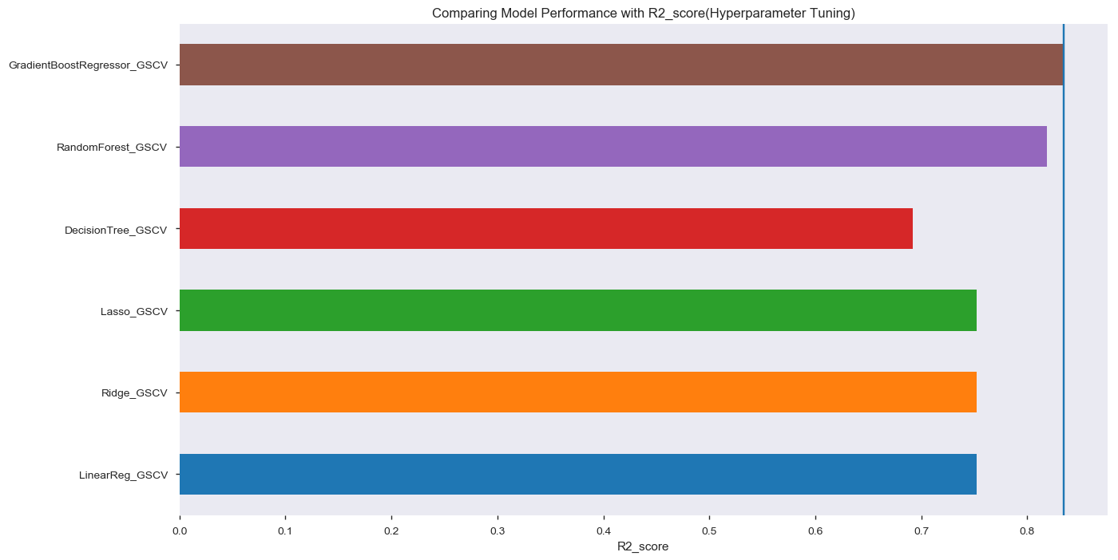
Machine Learning
Hyperparameter Tuning
30/31

Slide 31
Conclusion
Gradient Boosted Regression (GBR) is the most effective model with the R2 score around 0.86.
Random Forest Regression (RFR) is the second better model with the R2 score around 0.82.
I would recommend using tree-based models, which have higher performance for predicting house prices in King County.
31/31

